Slide 1

Problems on Conditional Probability 2012

Slide 2
Reference
Data
Youtube
Code

Slide 3
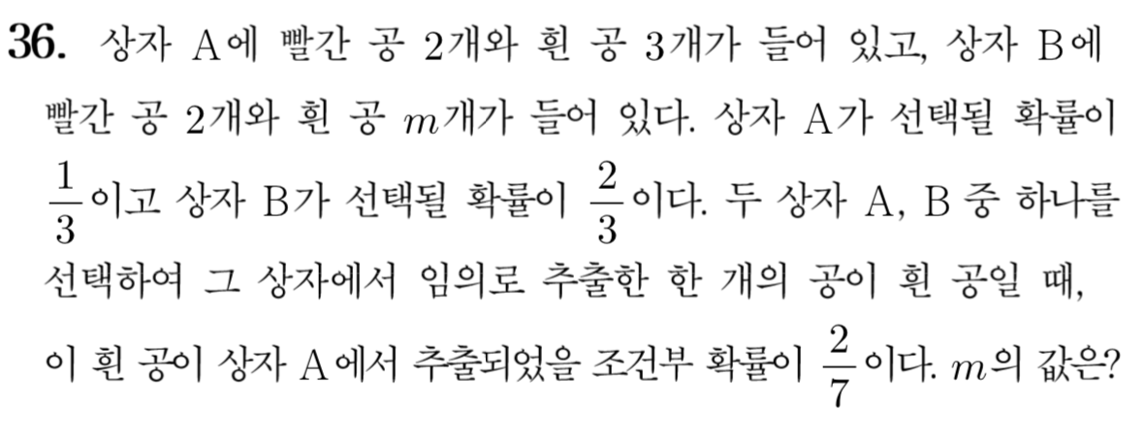
[2012]

Slide 4
